Slide 1

GOVT. ENGINEERING COLLEGE BIKANER SECURITY SYSTEM FOR DNS USING CRYPTOGRAPHY SUBMITTED BY:- Hawa Singh,(027) Madhur Dhodria,(038) CSE (IV^{rth} Year) CSE (IV^{rth} Year) hawakasana@gmail.com madhurdhodria96@gmail.com Ashok Kumar(14) CSE(IV^{rth} Year) pareekashok39@gmail.com

Slide 2
OBJECTIVE
To provide security by combining the concept of both the Digital
Signature and Asymmetric (public key) cryptography by sending the Public key
over the Network.

Slide 3
Overview of DNS
The DNS translates Internet domain and host names to IP address. DNS automatically converts the names we type in our Web browser address bar to the IP addresses of Web servers hosting those sites.
The mapping or binding of IP addresses to host names became a major problem in the rapidly growing Internet and the higher level binding effort went through.
We got the different stages of development up to
the currently used Domain Name System.

Slide 4
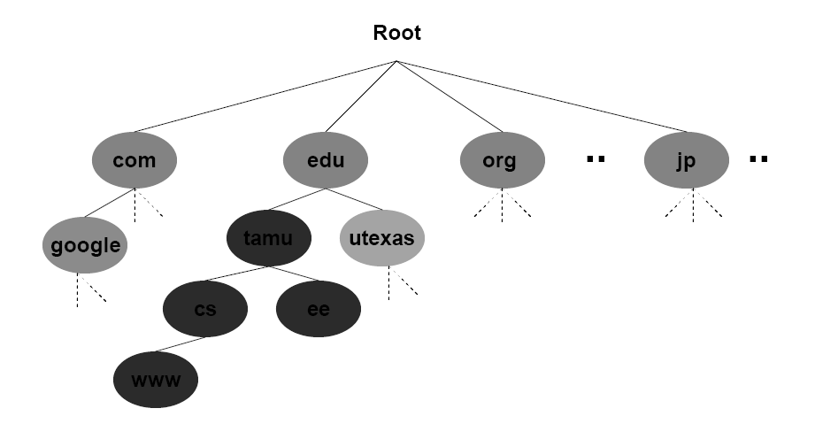
DNS Architecture

Slide 5
EXISTING SYSTEM
¬
¬
¬
The existing system is manually maintained. It uses RSA Algorithm for key generation.
Since it uses RSA Algorithm it is necessary to provide two Prime numbers to generate Key Pair which results in Mathematical and Brute force attack.
It sends the Public key through the Network. Time consumption
Low reliability
¬
¬
¬
DISADVANTAGES
¬
¬
¬
Error prone
Less operational speed Low speed communication

Slide 6
The Following function avoids the pitfalls of the existing system
Fast and efficient work
Ease of access to system
Manual Effort is reduced

Slide 7
PROPOSED SYSTEM
¬
Taking the security into consideration the best solution is using Pseudo Random Number Generator for generating Key Pair in a quick and more secured manner.
Use of MD5 (or) Message Digest and Compressing the message.
Signature is created using Private Key and Message Digest which is transmitted along with the Public Key.
The transfer of the packets from each System to System is shown using Graphical User Interface (GUI).
¬
¬
¬

Slide 8
ADVANTAGES OF PROPOSED SYSTEM
They are not limited to 1024 bits like DSA
They can use hash longer than 160 bits.

Slide 9
Overall Diagram
ORIGINAL
ENCRYPTION, KEY GENERATION,
SIGNATURE GENERATION, SIGNATURE VERIFICATION, DECRYPTION
ORIGINAL
RECEIVER
SENDER
MESSAGE
MESSAGE

Slide 10
IMPLEMENTATION
¬
¬
Authentication
Message Encryption using Message Digest Algorithm
Key Generation using PRNG Algorithm Signature Generation
Verifying Signature and Decrypting
¬
¬
¬

Slide 11
MODULES
Key Generation
Encryption and Decryption
Signature Creation
Signature Verification

Slide 12
MODULE DESCRIPTION
KEY GENERATION
Taking two prime numbers
Generating random numbers
Generating public and private keys
The key pair (public and private key) is generated using the Cryptography PRNG (Pseudo Random Number Generator) Algorithm.

Slide 13
Key Generation Module Design
PRNG ALGORITHM
CALL THE METHOD IN THE CODING
GENERATE TWO RANDOM NUMBERS (PUBLIC AND PRIVATE KEY)
DISPLAY THE KEYS IN THE BACK END
GENERATE SIGNATURE AND SEND

Slide 14
AUTHENTICATION
AUTHENTICATION
ENTER THE USER NAME AND PASSWORD
TEXT FILE
VERIFY
LOGIN
SEND MESSAGE OR ATTACHMENT

Slide 15
MESSAGE ENCRYPTION
MESSAGE DIGEST ALGORITHM
READ CHARACTER BY CHARACTER
CONVERT EACH CHARACTER TO ASCII CODE
CONVERT THE ASCII CODE TO HEX CODE
ENCRYPTED MESSAGE

Slide 16
SIGNATURE GENERATION
DSA ALGORITHM
PRIVATE KEY + ENCRYPTED TEXT FILE
GENERATE SIGNATURE PUBLIC KEY + SIGNATURE
SEND THROUGH THE NETWORK

Slide 17
VERIFYING SIGNATURE AND DECRYPTING
DESTINATION
PUBLIC KEY ,SIGNATURE FROM THE SENDER
GENERATE SIGNATURE USING DSA ALGORITHM
NO MATCH
DISCARD
VERIFY THE SIGNATURE
IF MATCHES
DECRYPT THE MESSAGE OR FILE
REPLY TO THE SOURCE

Slide 18
ATTACK ON ROOT SERVER
OCTOBER 23, 2012
Attack on root servers
9 out of 13 servers were down
Slowdown after 8 or more servers are down
No noticeable slowdown observed by users

Slide 19
ATTACK ON MICROSOFT
¬
¬
¬
¬
22.5 hour outage of web sites
Series of attacks on Name servers, Jan 2001
Reasons – attack or misconfiguration
Intermittent access to Microsoft.com, MSN.com
$200 million advertising campaign Microsoft Web sites drew 54 million unique
visitors in December
¬
¬

Slide 20
DNS SECURITY EXTENSION
Idea: Add a digital signature to each Name
Information
Signing with the zone’s private key
Authenticating with the zone’s public key
Main issue
Key genereation
DNS as Public Key Infrastructure

Slide 21
SYSTEM REQUIREMENTS
HARDWARE REQUIREMENTS
¬
¬
¬
PROCESSOR III AND ABOVE 20 GB HARD DISK
256 DDR RAM
SOFTWARE REQUIREMENTS
¬
¬
¬
MICROSOFT.NET FRAMEWORK 1.1 INTERNET INFORMATION SERVER BROWSER(I E OR NETSCAPE)

Slide 22
CONCLUSION:
The security threats for DNS was overcome by using public key validation and it was implemented and executed successfully

Slide 23
THANK YOU

